Slide 1
Implementation of Yoga Pose Estimation and Feedback Mechanism using Pose Detection for Self Learning
Team Members Panel Number:16
Project Advisor: Dr. K Raghesh Krishnan / Asst. Professor(SG) / CSE
S.No | Reg.No | Name of the Student | Section
1 | CB.EN.U4CSE18112 | DHANUSH V | CSE B
2 | CB.EN.U4CSE18162 | VENKAT R | CSE B
3 | CB.EN.U4CSE18174 | HARSHA VARDHAN D | CSE B
4 | CB.EN.U4CSE18511 | GUHAN K | CSE B

Slide 2
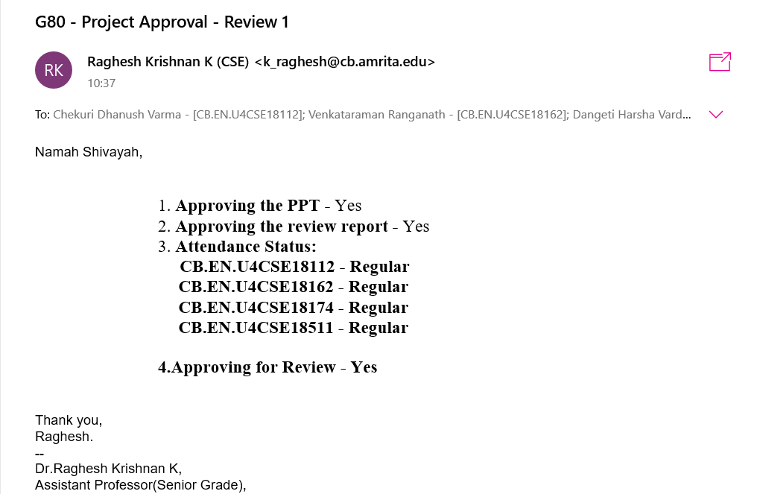
Guide Approval Mail

Slide 3
Problem Statement
To design a Machine Learning based application that monitors the yoga pose performed by the practitioner and gives real time feedback for improvement of the yoga posture.

Slide 4
Abstract
Living in this modern era, the brain is constantly engaged in hectic work and never rests in tranquility. As a result, there is a lack of focus on things, skills and vitality. Yoga which was developed in ancient India has numerous benefits such as relaxation of the mind, increased flexibility, metabolism, blood flow etc.
Beginners should strictly avoid doing yoga poses without supervision as slight errors can even lead to injuries and deformities. The pandemic has made it even harder for people to have an in-person trainer who can help the learner through supervision.

Slide 5
Abstract
This demands the requirement of an application that takes an asana as input from the learner and helps to improvise the yoga postures through feedback.
The proposed system assesses the Yoga posture of a learner by:
Detecting the human body first using the webcam.
Extracting the coordinated points of various joints in the body.
Calculating the difference of body angles between the trained pose images and that of the learner.
Provide real-time feedback on improvisation of the incorrect parts between learner and the trained images.

Slide 6
Review 0 Comments and Action Taken
COMMENTS | ACTION TAKEN
Dataset may be insufficient | Added Additional Sources of dataset which will be explained later in the presentation.

Slide 7
Literature Survey
S.No | Authors Name(s) | Full Title of the Paper with Year | Inference from the paper(based on methodology, technology) | Open Problem( for your proposed work)
1. | Yash Agrawal, Yash Shah, Abhishek Sharma | "Implementation of Machine Learning Technique for Identification of Yoga Poses", Communication Systems and Network Technologies (CSNT) 2020 IEEE 9th International Conference on, pp. 40-43, 2020. | Classification of yoga poses based on distance between joints calculated from images using coordinates extracted by tf-pose-estimation , and Machine Learning Algorithms (Logistic Regression, Random Forest, SVM, Decision Tree, Naive Bayes and KNN) . | Doesn't provide valuable feedback of how yoga practitioner practices a pose. Model trained only on datasets of the same person( no diversity in data)

Slide 8
Literature Survey
S.No | Authors Name(s) | Full Title of the Paper with Year | Inference from the paper(based on methodology, technology) | Open Problem( for your proposed work)
2. | Muhammad Usama Islam, Hasan Mahmud , Faisal Bin Ashraf, Iqbal Hossain and Md. Kamrul Hasan | "Yoga posture recognition by detecting human joint points in real time using microsoft kinect", Humanitarian Technology Conference (R10-HTC) 2017 IEEE Region 10, pp. 668-673, 2017. | Estimation of accuracy of the pose through data acquisition with the help of a Kinect device (kinect device can acquire different types of data in data acquisition step such as color, depth and skeleton information ). | Kinect is an expensive device for Motion sensing , not supported anymore by Microsoft, and requires high maintainability. Mere accuracy of the pose doesn’t help the learner to improve / correct his pose .

Slide 9
Literature Survey
S.No | Authors Name(s) | Full Title of the Paper with Year | Inference from the paper(based on methodology, technology) | Open Problem( for your proposed work)
3. | Deepak Kumar ,Anurag Sinha | ”Yoga Pose Detection and Classification Using Deep Learning” 2020 International Journal of Scientific Research in Computer Science Engineering and Information Technology ,Volume 6, Issue 6 pp: 160-184 2020 | Poses are classified using KNN , SVM , ANN , CNN using the features extracted from the yoga practitioner using OpenPose. | Classification model doesn’t give valuable information for the learner to improve /practise yoga. Model not trained on a diverse dataset.

Slide 10
Literature Survey
S.No | Authors Name(s) | Full Title of the Paper with Year | Inference from the paper(based on methodology, technology) | Open Problem( for your proposed work)
4. | Sankara Narayanan, Devendra Kumar Misra , Kartik Arora and Harsh Rai | “Yoga Pose Detection Using Deep Learning Techniques”” (May 10, 2021) Social Science Research Network (SSRN) | Compared the accuracy of classification of 2D and 3D model of OpenPose models by using Convolutional Neural Networks and finally Stated that 3D model of OpenPose Predicts more accurate form results compared to 2D models. | Inferred that 3D models are more accurate than 2D .yet Classification model doesn’t provide valuable feedback for the learner.

Slide 11
Literature Survey
S.No | Authors Name(s) | Full Title of the Paper with Year | Inference from the paper(based on methodology, technology) | Open Problem( for your proposed work)
5. | Thi-Lan Le , Minh-Quoc Nguyen , Thi-Thanh-Mai Nguyen | T.-L. Le et al., "Human posture recognition using human skeleton provided by Kinect", Proc. International Conference on Computing Management and Telecommunications, 2013. | Proposed a method for human posture recognition using skeleton provided by Kinect device and conducted 7 different experiments with 4 different features extracted from the tracked human skeleton. | Not a general application that could run on diverse Machines , dependent on Kinect device

Slide 12
Software/Tools Requirements
Tools | Functionality
Flask ( Python library ) | Front End
OpenCV | Used for Feature Extraction , Object Detection in this case the person and altering the orientation and brightness of images.
Media Pipe (coordinates extraction) | Media Pipe offers open source cross-platform, customizable ML solutions for live and streaming media.
Visual Studio Code | Code editor redefined and optimized for building and debugging modern web and cloud applications
TensorFlow | Provides a collection of workflows to develop and train models using Python or JavaScript, and to easily deploy in the cloud, on-prem, in the browser or on-device

Slide 13
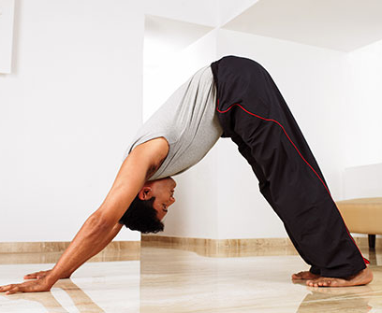
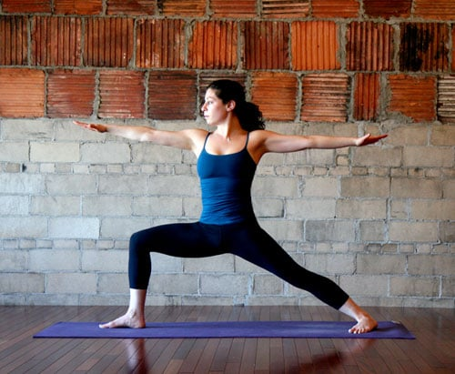

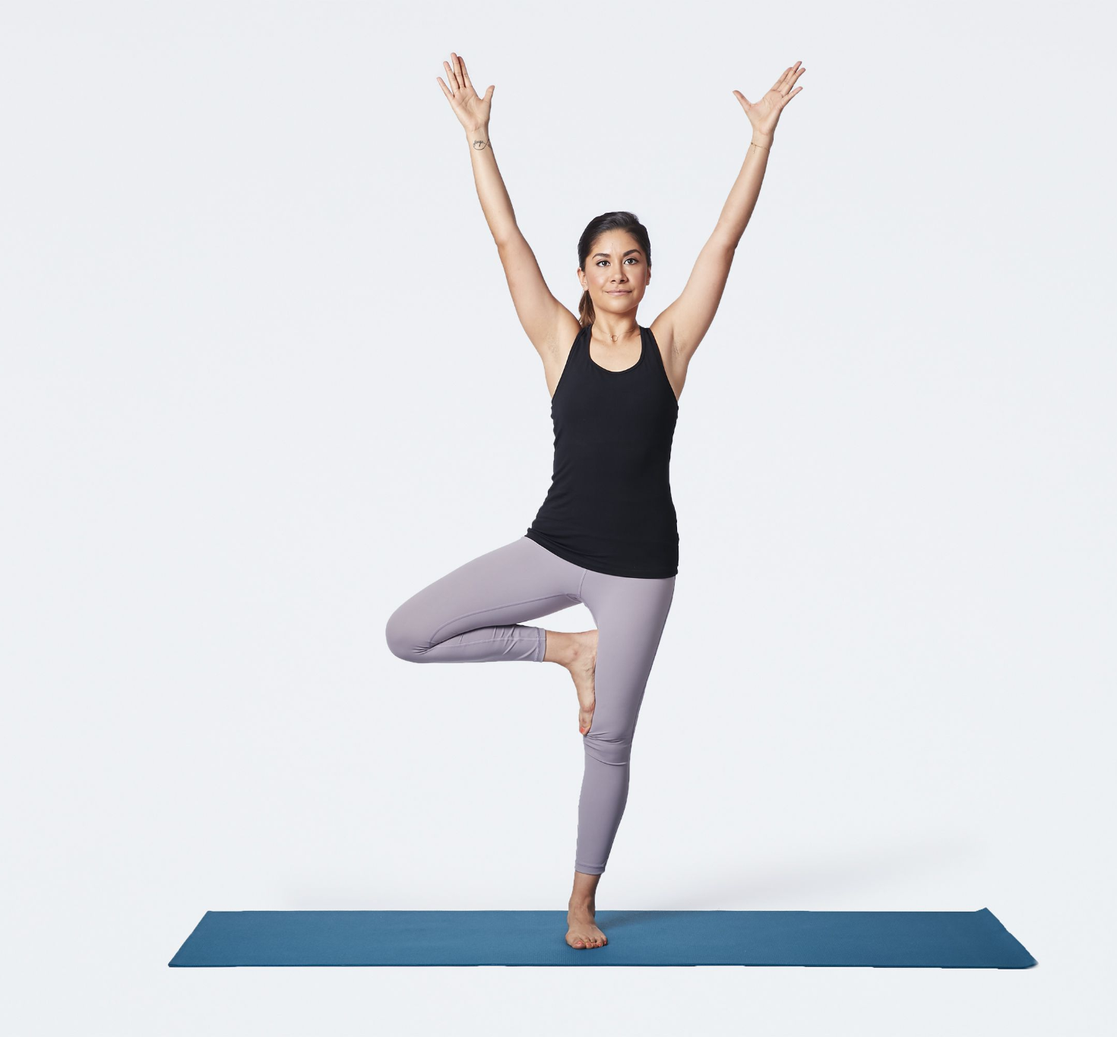
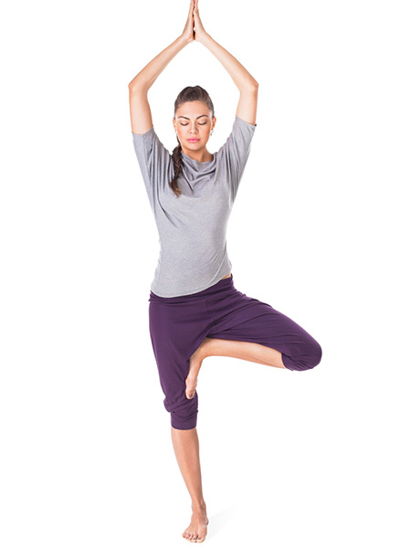
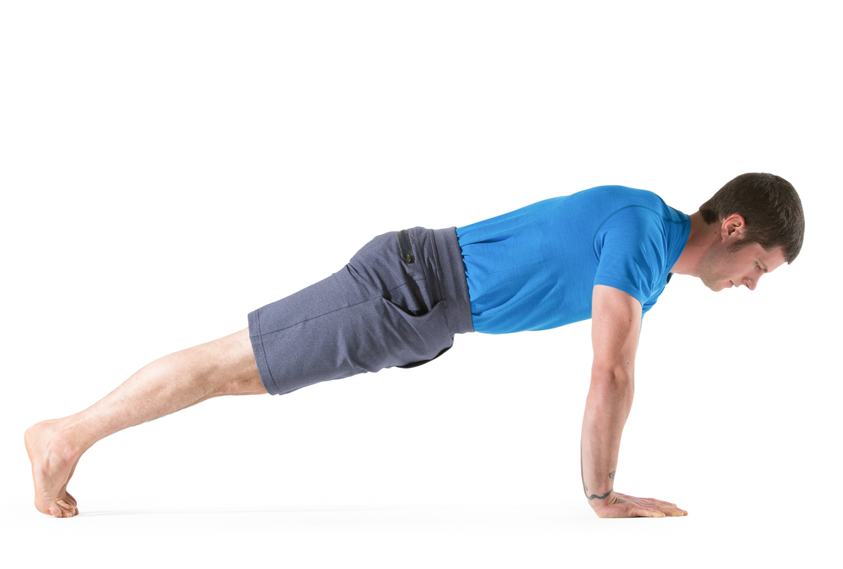
Data Set
Source of data set : https://www.kaggle.com/niharika41298/yoga-poses-dataset
https://sites.google.com/view/yoga-82/home
Sample data set :
downdog warrior goddess Tree Plank
Justification :
The combined dataset contains-
900 + diverse images (Children , Women and Men) for each pose
Images in different Lightings/orientation for each yoga pose .

Slide 14
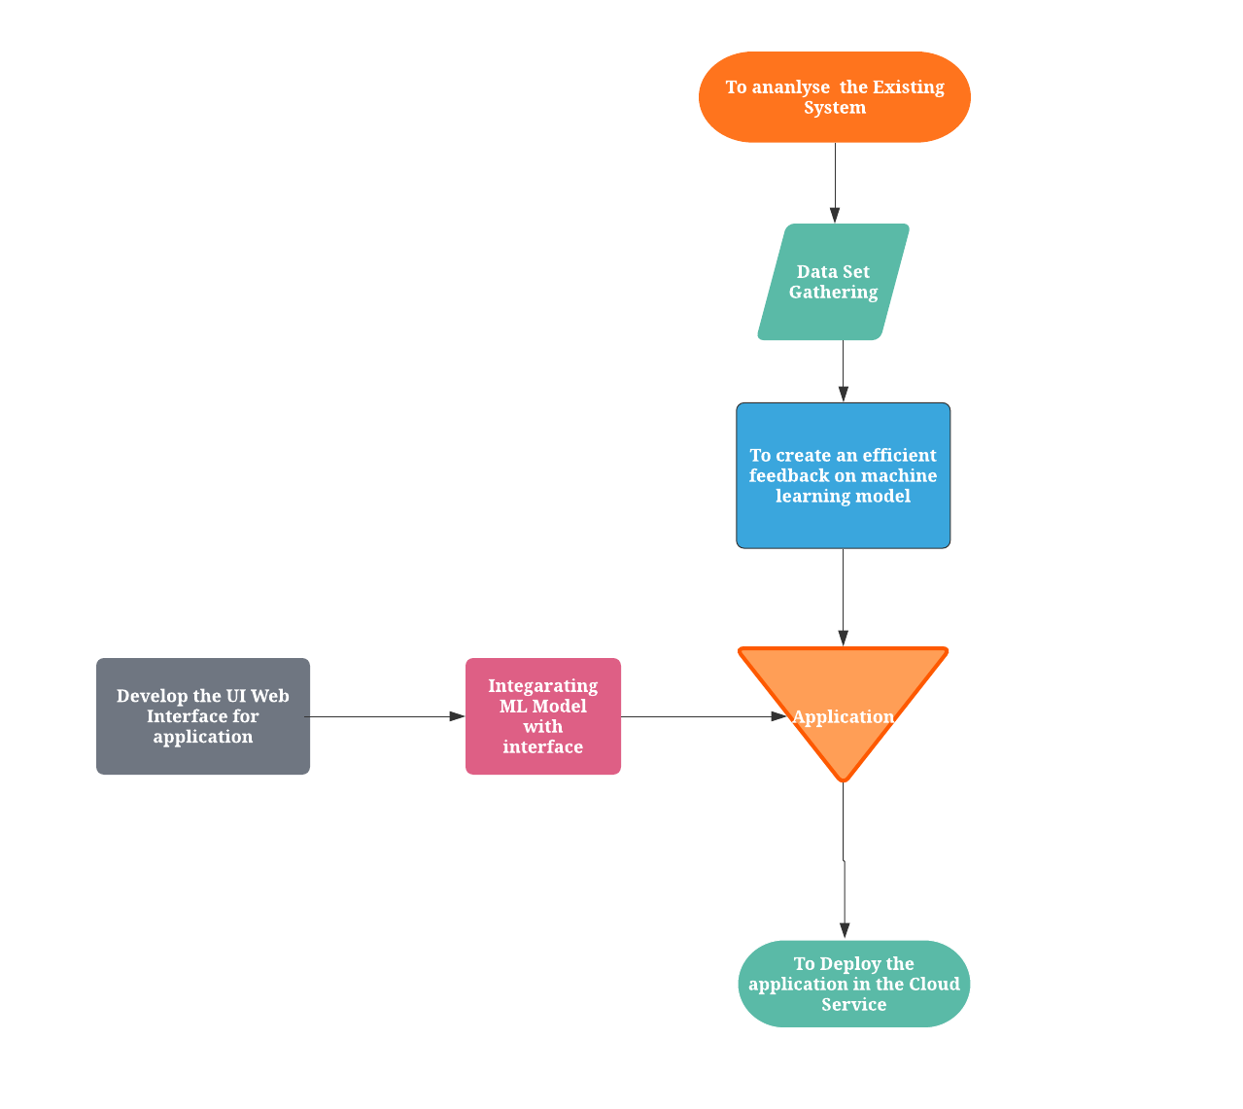
Modularization

Slide 15
Responsibilities of Team Members
Modules | Group Member
Analyze the existing models/ systems | Ch.Dhanush Varma D. Harshavardhan K. Guhan R. Venkataraman
Preparing the image data set from the various data sources | R. Venkataraman
Preprocessing the image data set | D. Harshavardhan
Extracting the body features using Mediapipe pose | K. Guhan
To create an efficient feedback based machine learning models | K. Guhan R. Venkataraman
Develop the UI Web Interface for application | Ch. Dhanush Varma D. HarshaVardhan
Integrating ML Model with interface | R. Venkataraman K. Guhan
To Deploy the application in the Cloud Service | D.Harshavardhan

Slide 16
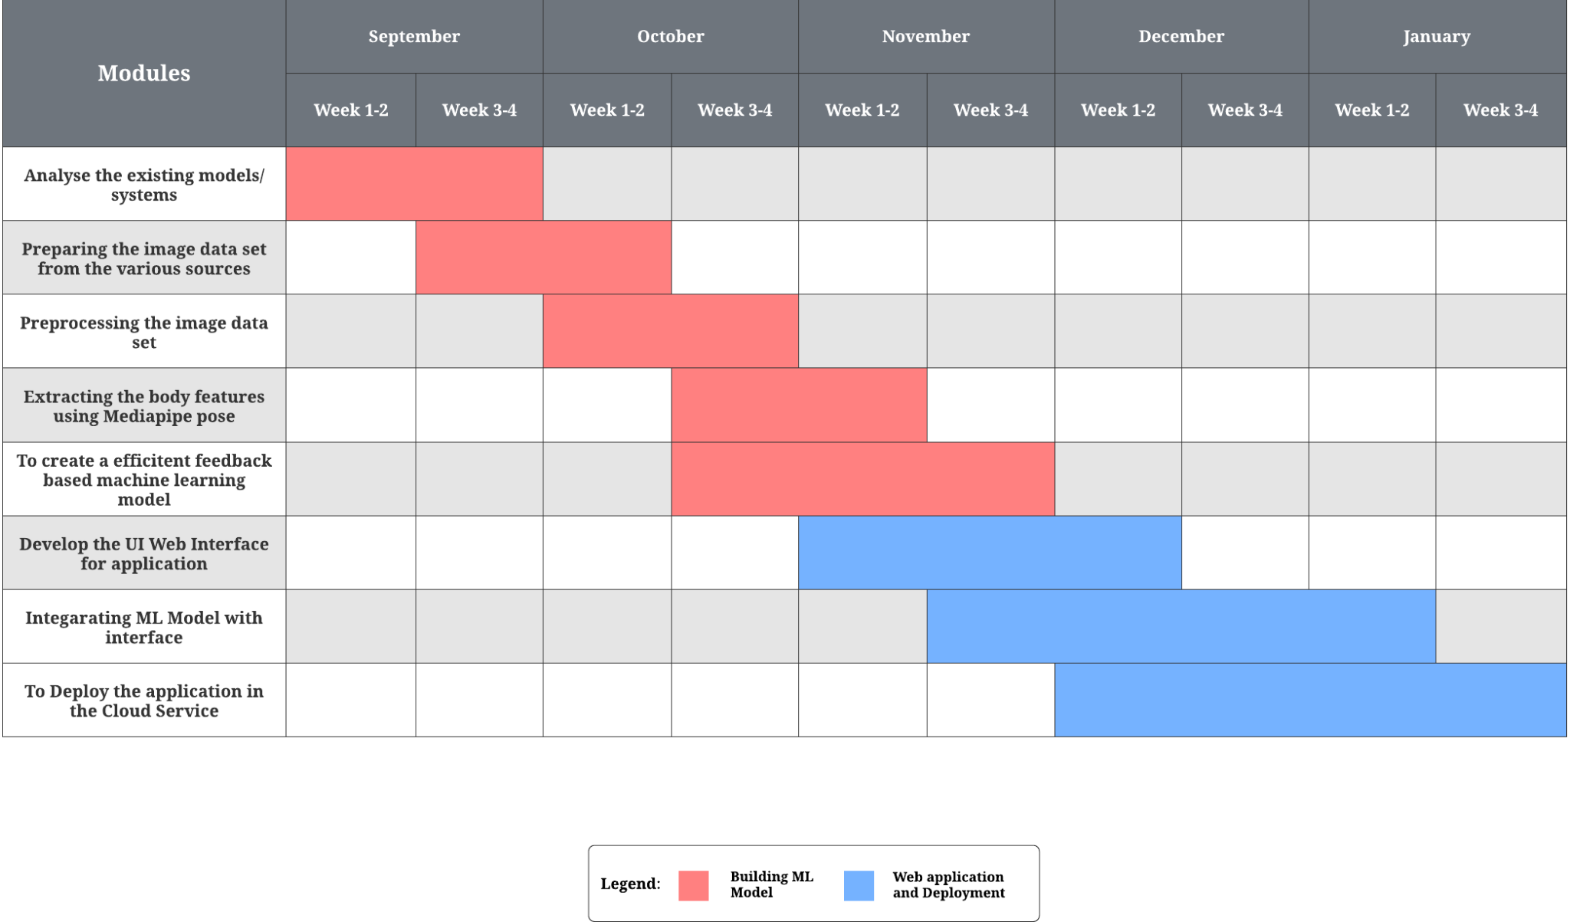
Month Wise Plan

Slide 17
References
Yash Agrawal, Yash Shah, Abhishek Sharma, "Implementation of Machine Learning Technique for Identification of Yoga Poses", Communication Systems and Network Technologies (CSNT) 2020 IEEE 9th International Conference on, pp. 40-43, 2020. https://ieeexplore.ieee.org/document/9115758
Maybel Chan Thar, Khine Zar Ne Winn, Nobuo Funabiki, "A Proposal of Yoga Pose Assessment Method Using Pose Detection for Self-Learning", Advanced Information Technologies (ICAIT) 2019 International Conference on, pp. 137-142, 2019. http://ieeexplore.ieee.org/document/8920892/
Muhammad Usama Islam, Hasan Mahmud, Faisal Bin Ashraf, Iqbal Hossain, Md. Kamrul Hasan, "Yoga posture recognition by detecting human joint points in real time using microsoft kinect", Humanitarian Technology Conference (R10-HTC) 2017 IEEE Region 10, pp. 668-673, 2017.
https://ieeexplore.ieee.org/document/8289047
Deepak Kumar, Anurag Sinha, ”Yoga Pose Detection and Classification Using Deep Learning” 2020 International Journal of Scientific Research in Computer Science Engineering and Information Technology https://ijsrcseit.com/CSEIT206623
T.-L. Le et al., "Human posture recognition using human skeleton provided by Kinect", Proc. International Conference on Computing Management and Telecommunications, 2013. https://ieeexplore.ieee.org/document/6482417
Sankara Narayanan, Devendra Kumar Misra , Kartik Arora and Harsh Rai, “Yoga Pose Detection Using Deep Learning Techniques” 2021 Social Science Research Network (SSRN)
https://papers.ssrn.com/sol3/papers.cfm?abstract_id=3842656

Slide 18
THANK YOU

